Slide 1
Objectives
In this lesson, you will learn to:
Create groups of elements and attributes in an XML schema
Use the following XSD elements:
  sequence
  group
  choice
  all
  attributeGroup

Slide 2
Problem Statement 4.D.1
  CyberShoppe requires a centralized repository of data about its customers. For this purpose, the data needs to be collated from the branch offices that maintain data on their computerized systems. The data needs to be maintained at a centralized location so that it is available to various sections including the Accounts and the Sales sections of various branches, regardless of the hardware and software platforms being used at the branches. After collating the data about customers from various branches, the head office needs to verify that all the required information is supplied by the branch offices. It also needs to verify that the data is stored in a consistent format.
  The data to be stored includes customer ID, first name, last name, and contact information, such as address and phone number. A customer may specify residential or official contact information.

Slide 3
Task List
Identify the elements and attributes required to store data.
Identify the elements and attributes that need to be grouped.
Identify a mechanism for grouping elements and attributes in a schema.
Declare a group of elements and attributes in a schema.
Create an XML document to store data.
Validate the XML document against the schema.

Slide 4
Task 1: Identify the elements and attributes
required to store data.
Result
The elements required for storing details about customers in an XML document are:
  CUSTOMERDATA
  CUSTOMER
  FIRSTNAME
  LASTNAME
  CONTACTINFO
  RESIDENCE
  OFFICE

Slide 5
Task 1: Identify the …to store data. (Contd.)
  ADDRESS
  PHONE
The attribute required for storing details about customers is:
  CUSTOMERID

Slide 6
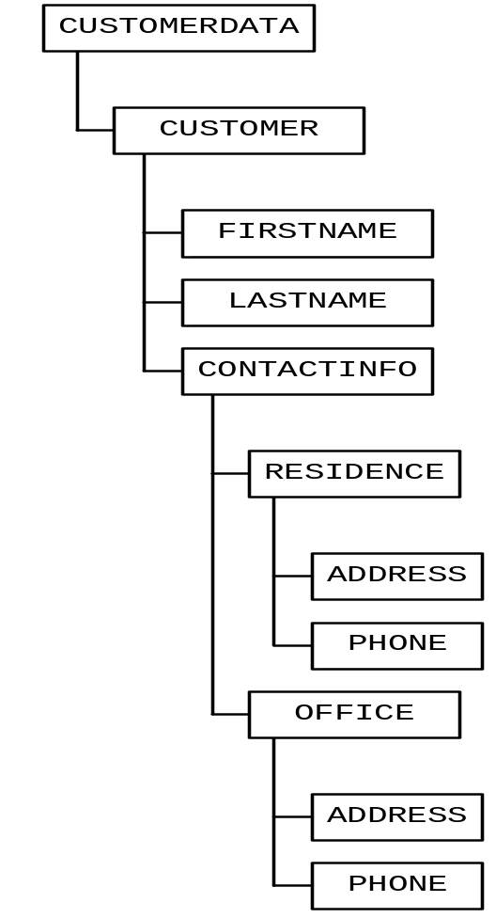
Task 1: Identify the … to store data. (Contd.)

Slide 7
Task 2: Identify the elements and attributes that need to be grouped.
XSD enables you to combine related elements and attributes into groups. This feature of creating grouped elements and attributes enables you to perform the following tasks:
  Create a reusable group of elements and attributes:
    A reusable group can be used to specify the content model for a complex type.
    This eliminates the task of declaring the elements, which have already been declared in some other context.

Slide 8
Task 2: Identify the …to be grouped. (Contd.)
  Select a single element from a group:
    At times, you may want to use just one element or attribute from a group. For example, you may want to specify either the residence or the office phone number of an employee.
    You can create a group of such elements and allow one of them to be used in the XML document.

Slide 9
Task 2: Identify the …to be grouped. (Contd.)
  Specify the sequence of elements:
    You can create a group of elements and specify the sequence in which each element in the group should appear in the XML document.

Slide 10
Task 2: Identify the …to be grouped. (Contd.)
Result
The various elements required to store customer details can be grouped as follows:
  ADDRESS and PHONE:
    Since these elements are used in RESIDENCE as well as OFFICE elements, these elements can be grouped together as ADDPHONE.
    This group can then be reused within the declaration of the RESIDENCE and OFFICE elements.

Slide 11
Task 2: Identify the … to be grouped. (Contd.)
  OFFICE and RESIDENCE:
    These elements can be grouped together to ensure that only one of them is used for each occurrence of the CUSTOMER element.

Slide 12
Task 3: Identify a mechanism for grouping
elements and attributes in a schema.
XSD provides a number of elements that can be used to group user-defined elements and attributes. These are:
  sequence
  group
  choice
  all
  attributeGroup

Slide 13
Task 3: Identify a mechanism …in a schema.
(Contd.)
The sequence Element
  The sequence element helps you ensure that elements declared within the opening and closing tags of this element appear in a specific order.

Slide 14
Task 3: Identify a mechanism …in a schema.
(Contd.)
The group Element
  In XSD, a set of elements can be grouped together by a common name and incorporated into a complex data type.
  Grouping of elements is beneficial when you want a set of related elements to be referred by a common name.

Slide 15
Task 3: Identify a mechanism … in a schema.
(Contd.)
  The following is the syntax for declaring a group element:
  <group maxOccurs="nonNegetiveInteger | unbounded" minOccurs="nonNegetiveInteger" name="NCName" ref="QName"> </group>

Slide 16
Task 3: Identify a mechanism … in a schema.
(Contd.)
  The following table describes the attributes of the group element:
Attribute | Description
maxOccurs | Used to specify the maximum number of times a group can occur in the XML document. The value of the maxOccurs attribute must be an integer greater than or equal to zero. If you do not want to set a limit on the maximum number, you can specify "unbounded" as the value to this attribute.
minOccurs | Used to specify the minimum number of times a group can occur in the XML document. The value of the minOccurs attribute must be an integer greater than or equal to zero. To specify that the group is optional, set the value of this attribute to zero.

Slide 17
Task 3: Identify a mechanism … in a schema.
(Contd.)
Attribute | Description
name | Used to assign a name for the group element. The name assigned to the group must not contain any colon.
ref | Used to refer to a group in a complex type element.

Slide 18
Task 3: Identify a mechanism … in a schema.
(Contd.)
The choice Element
  XSD enables you to specify alternative options by using the choice element.
  The choice element allows only one of the elements contained in the group to be present within the parent element.

Slide 19
Task 3: Identify a mechanism … in a schema.
(Contd.)
  The syntax for declaring a choice element:
  <choice id="ID" maxOccurs="nonNegativeInteger|unbounded" minOccurs="nonNegativeInteger" > </choice>
  In the above syntax, id, maxOccurs, and minOccurs are the attributes of the choice element.
  These attributes are similar to the attributes of the group element mentioned earlier.

Slide 20
Task 3: Identify a mechanism … in a schema.
(Contd.)
The all Element
  The all element enables you to use the child elements in any order as against the sequence element, which specifies the order in which the child elements must appear.
  The syntax for using the all element:
  <all maxOccurs="positiveInteger" minOccurs="0|1"> </all>
  In the above syntax, the maxOccurs and minOccurs attributes have the same meaning as the maxOccurs and minOccurs elements of the group element.

Slide 21
Task 3: Identify a mechanism … in a schema.
(Contd.)
The attributeGroup Element
  XSD also enables you to group attributes that can be reused with different elements.
  You can group attributes by using the attributeGroup element.

Slide 22
Task 3: Identify a mechanism … in a schema.
(Contd.)
  The syntax of the attributeGroup element:
    <attributeGroup
    attribute1
    attribute2
    :
    </attributeGroup>
  In the above syntax, attribute1 and attribute2 are the declaration statements of the various attributes that are to be grouped using the attributeGroup element.

Slide 23
Task 3: Identify a mechanism … in a schema.
(Contd.)
Result
In the given scenario, you need to use the following XSD elements:
  To group the ADDRESS and PHONE elements under a common name, you need to use the group element of XSD.
  To group the RESIDENCE and OFFICE elements and to ensure that only one of them can be used for each occurrence of the CUSTOMER element, you need to use the choice element of XSD.

Slide 24
Task 4: Declare a group of elements and
attributes in a schema.
Task 5: Create an XML document to store data.
Task 6: Validate the XML document against the
schema.

Slide 25
Just a Minute…
CyberShoppe sells books to its customers. The book details consist of the name of the book, the name of the author of the book, and the price of the book. The name of the authors of the book can be entered either by using the NAME element or by using the FIRSTNAME and LASTNAME elements.

Slide 26
Problem Statement 4.P.1
  CyberShoppe needs to store the details about its suppliers at a centralized location. Supplier details include the supplier ID, first name, last name, supplier type, address, and phone number. The supplier ID must begin with the character S followed by three digits. This ID must be capable of being reused across documents. The supplier type can be either INDIVIDUAL or COMPANY. The XML document can contain either a combination of the FIRSTNAME and LASTNAME elements for storing the supplier name or it can contain just the NAME element. It must be ensured that either the combination or the single element must be used to store the supplier name. The supplier data must be validated to ensure that it conform to the rules specified above in order to maintain data integrity.

Slide 27
Summary
In this lesson, you learned that:
You can group elements and attributes using the following elements:
  sequence: Allows you to create a group of elements and specify that all the elements within the group should appear in the same sequence in which they are declared.
  group: Allows you to group a set of elements and use a common name to refer to these elements. This group can be incorporated into a complex data type.

Slide 28
Summary (Contd.)
  choice: Allows you to specify that only one of the specified set of elements can be used at a time.
  all: Allows you to create a group of elements that can be used in any sequence within the parent element.
  attributeGroup: Allows you to create a group of attributes that can be reused in different elements.

